Slide 1
Robot Project Meeting – 2 13/09/2018
Bourgogne, Colrat, Evaux, Gaizi, Nicolle – ACE TEAM

Slide 2
Last Meeting :
These were the points discussed:
Dividing tasks between students (please check .ppt)
Needed equipment
Setting biweekly meetings for status check
To be done:
@Alex: order 5-6 TC297 AppKits - Done
@Alex: give contact details of Rahul for Camera - Done
@Alex & Abdoul: Get equipment: oscilloscope and supply voltage - Done
@All Students: decide on deadlines and divide in subtasks - Done
@All Students: Switch project from TC277 to TC297 - Done
@Amine: Send the update .pptx containing deadlines and subtasks - Done
@Amine: Set biweekly meetings and send invite - Done

Slide 3
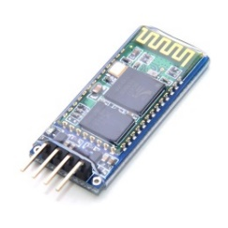
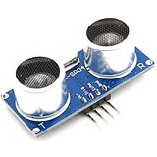
Work Planning Reminder
First Step:
Movements: PWM & encoders configuration is working
Adjust Speed, direction, encoders data processing Amine
Communication: Board with Bluetooth Module Virgile
Send instructions to the Board that should understand them
Ultra Sonic Obstacle detection Marlon
Analyze the environment

Slide 4
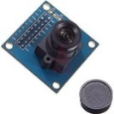
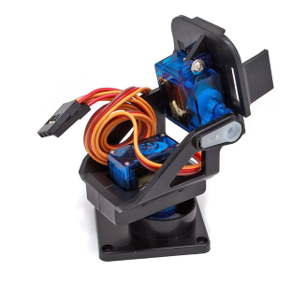
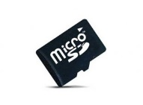
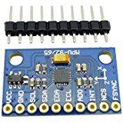
Work Planning Reminder
Second Step:
Camera integrated to the robot Maxime
Tough module, takes time to program
Servomotors to change the angle of the camera with PWM
Save pictures in SD Card
Movements enslavement (PID) Virgile
Gyroscope: Amine and/or Marlon
Mapping of the environment’s obstacles with collected data (ultra sonic, camera, gyroscope)

Slide 5
Subtasks: Amine Movements
Done:
Solder a circuit with H-bridge, Board, Encoders
Movements in all 4 directions witht the wanted direction and angle
Speed adjustments of the wheels hard coded after PWM tests
Real time speed adjustment needed
Shared Excel PinMap file with Guillaume
To do:
Documentation: Comments + Wiki deadline 19/09/2018
Movement Enslavement (PID) deadline not determined yet

Slide 6
Subtasks: Marlon, Ultrasonic Sensor
Done
Configure external interrupt
Send trigger signal
Process signal from echo pin
Comment
To do
Write in wiki deadline 25/09/18

Slide 7
Subtasks: Virgile, Bluetooth communication
Done:
Read the documetation of the Bluetooth module (HC06)
Uses UART communication
Programable Baudrate:1200Baud -> 1382400Baud
Choose the interface on the AURIX TC297 (ASCLIN1)
To do:
Learn and Configure the ASCLIN (deadline: 21/09/2018)
Implement the code on the robot (deadline: 28/09/2018)

Slide 8
Substaks: Maxime, Camera
Subtasks
Camera sends constant stream over the CIF interface (visualized on the TFT screen of the Application Kit)
Next steps :
Capture images of the stream by the CIF Interface and store them on an SD card
Image processing (detect numbers ➔ CNN Yolov2) on :
A computer → Establish a new communication : PC / Aurix
or The Aurix → uPython
Deadline
Beginning of November

Slide 9
Recap: Guillaume, coding on Aurix
What I did/or am doing:
Learning to use the Aurix environment (Led switch on, toggle etc.)
Learning how to use interrupts with SMU device
Next Week:
Finish interruptions
Learn how to use timer interrupts

Slide 10
Next Priorities
Bluetooth Module to send instructions to the Robot
The movement instruction should not be hard coded anymore
Movements enslavement
The robot should be able to go straight despite disruptions
Example: one motor going faster than the other one etc.

Slide 11
Any question or request ?

